Slide 1





Travelling – Blog website
Team Members:
Shubham sahay: 2101610130070
Shobit kashyap : 2101610100207
Navanit vishwakarma : 2001610130047
Shiv shankar : 2001610100082 Guide:Kaushal sir
Disclaimer: The content is curated for educational purposes only.

Slide 2
OUTLINE
Abstract
Problem Statement
Aims, Objective & Proposed System/Solution
System Design/Architecture
System Development Approach (Technology Used)
Algorithm & Deployment
Conclusion
Future Scope
References
Video of the Project
Notes:
These are the list of chapters that we are going to cover in these foundation codes. Those are chapter one what are AI and ML? chapter 2 applied Python programming in AI, and chapter 3 is exploratory data analysis for ML.

Slide 3
Abstract Explore the world with our dynamic travel website! Discover diverse destinations, from serene beaches to bustling cities, through vivid descriptions and stunning visuals. Plan your perfect itinerary using our user-friendly interface, tailored to suit every traveler's preferences. Uncover hidden gems with insider tips and detailed guides, ensuring an enriching journey. Access exclusive deals on accommodations, transportation, and activities, optimizing your travel budget. Connect with fellow adventurers through our vibrant community, sharing experiences and creating lasting memories. Embrace the spirit of exploration and embark on unforgettable adventures with ease, all in one comprehensive platform."

Slide 4
Problem Statement TravellingBlog faces challenges of engaging diverse audiences with unique travel preferences, struggling to offer comprehensive, niche-specific content. Users encounter scattered, inconsistent information, leading to decision paralysis and dissatisfaction. Additionally, the platform lacks an interactive community, limiting shared experiences and personal recommendations. Users seek real-time updates, but the blog lacks timely content refreshment, affecting its relevance. 1. Content Diversity 2. Information Consistency 3. Community Engagement 4. Timeliness of Updates 5. Desire for a Centralized Hub

Slide 5
Aim and Objective Aim: The aim of TravellingBlog is to become the ultimate destination for all travel enthusiasts, offering a diverse array of comprehensive and niche-specific content that caters to every traveler's unique preferences. We strive to provide a cohesive platform that fosters a vibrant and engaged community, encouraging shared experiences, personal recommendations, and interactive discussions. Our goal is to ensure timely and relevant updates, keeping users informed about the latest trends and destinations.
Objectives:
1.Content Diversit 2.Community Engagement 3. Timely and Relevant Updates 4. Enhanced User Experience

Slide 6
Proposed Solution Content Curation Overhaul: Implement a systematic approach to curate diverse and niche-specific content, employing expert contributors to ensure comprehensive coverage and authenticity. Community Engagement Features: Introduce interactive features such as forums, user-generated content sections, and live Q&A sessions to foster a vibrant and engaged community of travelers. Agile Content Management: Establish a content refreshment strategy with regular updates, leveraging real-time trends and user feedback to ensure timely and relevant information. User-Centric Design Revamp: Revise the website interface, focusing on a responsive, intuitive design for seamless navigation and enhanced user experience across devices, prioritizing user accessibility and ease of exploration.

Slide 7
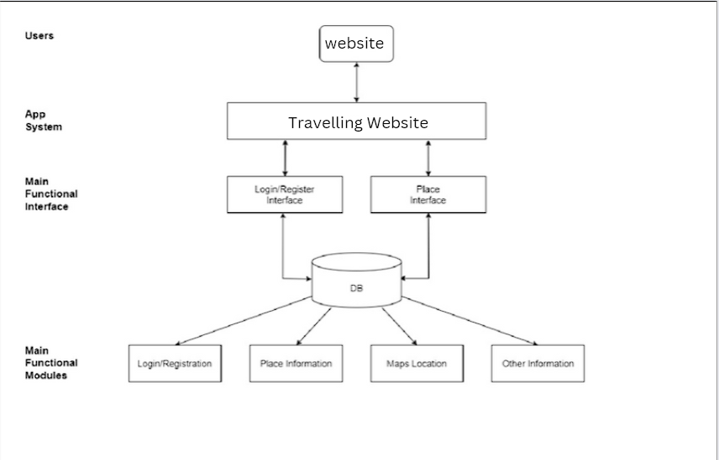
System Architecture The user interface (UI) is the point of human-computer interaction and communication in Client Application: Handles user interaction and sends CRUD requests.
API Gateway: Receives requests and routes them to services. CRUD Service: Performs Create, Read, Update, and Delete operations on data.
Data Storage: Stores and retrieves data efficiently and securely.

Slide 8
System Deployment Approach
Assessment and Planning: Conduct a comprehensive analysis of current website infrastructure, content, and user feedback to identify improvement areas.
Iterative Development: Employ an agile development methodology to implement enhancements in phases, focusing on critical areas like content curation, community features, and user interface improvements.
Testing and Feedback Integration: Conduct rigorous testing at each stage to ensure functionality and user experience optimization. Incorporate user feedback loops to refine features and address any usability concerns.
Rollout and Monitoring: Gradually deploy enhancements while monitoring performance metrics and user engagement. Continuously assess and refine the system post-deployment based on real-time data and user interactions to ensure sustained improvement.

Slide 9
Algorithm & Deployment
Content Algorithm Development: Create an algorithmic framework to categorize and recommend diverse and personalized travel content based on user preferences, engagement metrics, and trending topics.
Iterative Deployment Process: Implement changes in phases, starting with content algorithm integration, followed by community engagement features and interface enhancements.
A/B Testing & Optimization: Conduct A/B testing to fine-tune algorithms and features, optimizing content relevance, community interaction, and user experience.
Gradual Rollout & Continuous Monitoring: Deploy updates gradually, monitoring performance metrics, user feedback, and algorithm effectiveness post-deployment. Continuously iterate based on insights to ensure sustained improvements in content delivery and user engagement.

Slide 10
Conclusion TravellingBlog continues its journey to redefine travel experiences. With evolving technology and user-centric enhancements, it aims to provide personalized, immersive, and community-driven adventures. Embracing innovation, it envisions a future where every traveler finds their perfect itinerary, engages with a global community, and explores destinations in unprecedented ways. As it moves forward, fostering trust, sustainability, and seamless user interactions remains pivotal. TravellingBlog stands committed to shaping a travel platform that not only informs but also inspires, creating unforgettable journeys for all who seek to explore the world.

Slide 11
Future Scope The website will be updated with many other payment options and new wallet and methods will be added for buying the packages instead of email contact.

Slide 12
Reference
References that helped me building this website:
⮚ www.w3schools.com (For HTML, CSS and JS)
⮚ www.tutorialspoint.com
⮚ www.envanto.com (For website UI inspiration)
⮚ www.carbonmade.com
⮚ www.behance.net
⮚ React- The Complete Guide (incl Hooks,React Router)
Notes:
Reference
These are the references for this session.
12

Slide 13
Thank you!
Notes:
thank you very much for joining this PPT, keep learning.
13

